Slide 1
ANZ VIRTUAL INTERNSHIP PREDICTIVE ANALYSIS
Prepared by Satinderjit Singh
Computer Engineer
Thapar Institute of Engineering and Technology

Slide 2
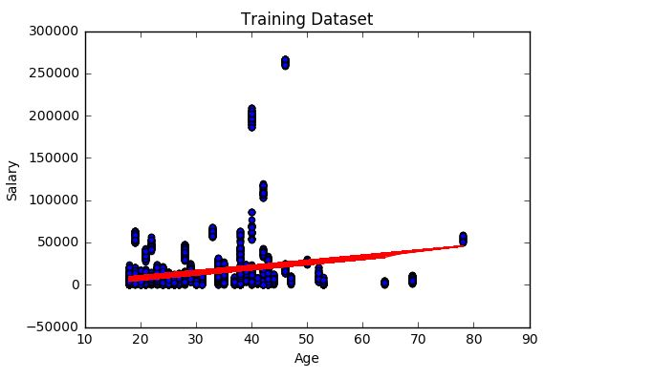
LINEAR REGRESSION MODEL

Slide 3
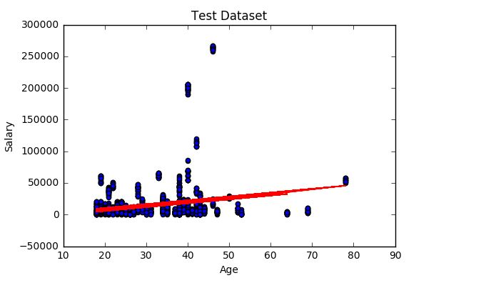
LINEAR REGRESSION MODEL

Slide 4
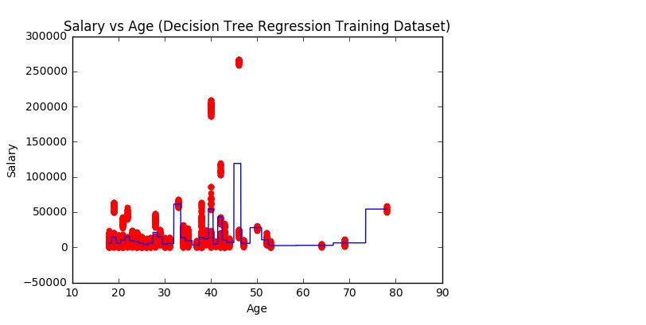
DECISION TREE MODEL

Slide 5
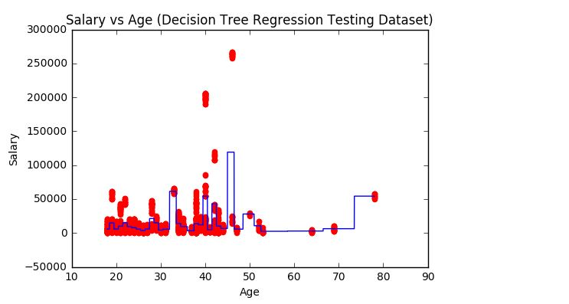
DECISION TREE MODEL

Slide 6
Model Evaluation
Root Mean Squared Error in Linear Regression = 31780.6
Root Mean Squared Error in Decision Tree Model = 25237.2
Therefore our Decision Tree Model performs better than Linear Regression Model based on RMSE.

